Slide 2
History
Anangu Pitjantjatjara Yankunytjatjara (APY) Lands has always had unsealed roads.
There have been many calls for APY roads to be upgraded, from these sources:
Anangu leaders and Communities
Community Plans
Study’s
Reports
Notes:
Anangu Pitjantjatjara Yankunytjatjara (APY) Lands has always had unsealed roads.
There have been many calls for APY roads to be upgraded, from sources:
Anangu leaders and Communities
Community Plans
Study’s
Reports

Slide 3
Why is the upgrade necessary
The need for road upgrades was formally identified through the Community Structure Plans for nine major APY communities.
The upgrade will:
Improve road safety
Improve accessibility to and between the APY Lands communities
Improve emergency response to communities
Notes:
Anangu Pitjantjatjara Yankunytjatjara (APY) Lands has always had unsealed roads.
There have been many calls for APY roads to be upgraded, from sources:
Anangu leaders and Communities
Community Plans
Study’s
Reports

Slide 4
Funding
The South Australia State Government prepared a bid to Infrastructure Australia to improve 210km of the main access road and 21km of community access roads in the APY Lands.
The bid was developed through the collaboration of:
Department of the Premier and Cabinet
Department for Manufacturing, Innovation, Trade, Resources and Energy
Department of Planning, Transport and Infrastructure
Notes:
About the Money
The South Australia Government prepared a bid for the improvement of :
210km of the main access road and
21km of Community Access Roads
Commonwealth Government $85 million
SA State Government $21 million
Total project funding $106 million

Slide 5
Funding
In December 2013 the Australian Government confirmed project funding on an 80:20 basis with the State Government over a five year period.
Australian Government $85 million
State Government $21.25 million
Total project funding $106.25 million
Notes:
About the Money
The South Australia Government prepared a bid for the improvement of :
210km of the main access road and
21km of Community Access Roads
Commonwealth Government $85 million
SA State Government $21 million
Total project funding $106 million

Slide 6
Locality Plan
Notes:
210km of APY Main Access Road and 21km of Community Access Roads
The upgraded road will
improve road safety
Improve travel between communities
Improve accessibility to communities
Improve emergency responses:
Medical
Police

Slide 7
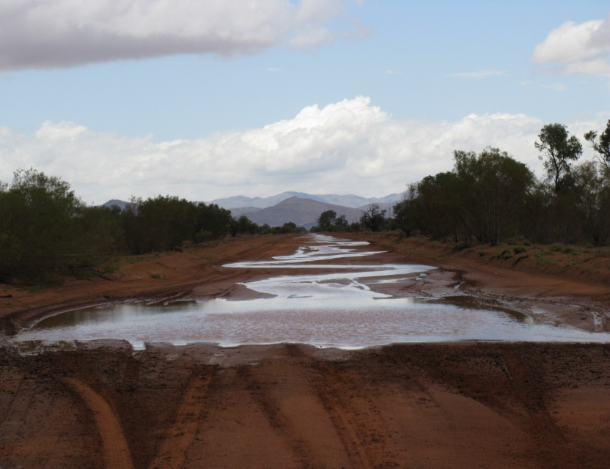
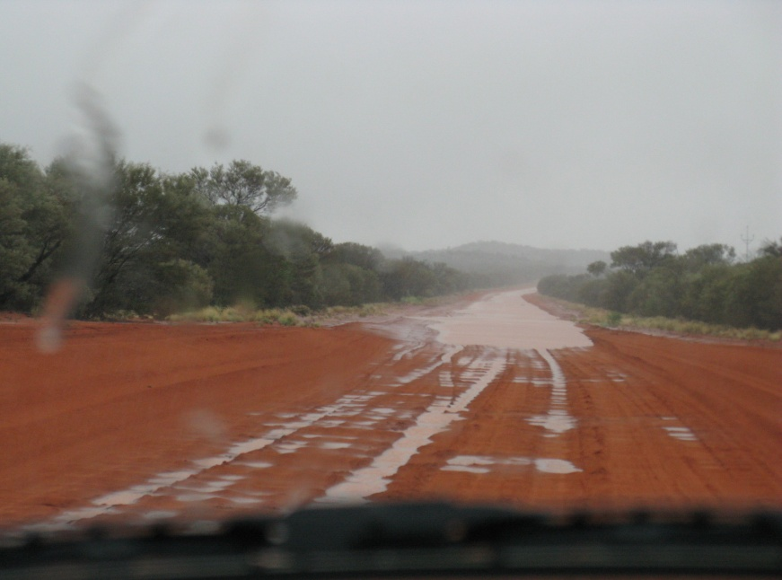
Notes:
In the wetter months, because the Main access road is below natural surface there is frequent flooding of the road and can sometimes be impossible to drive through

Slide 8
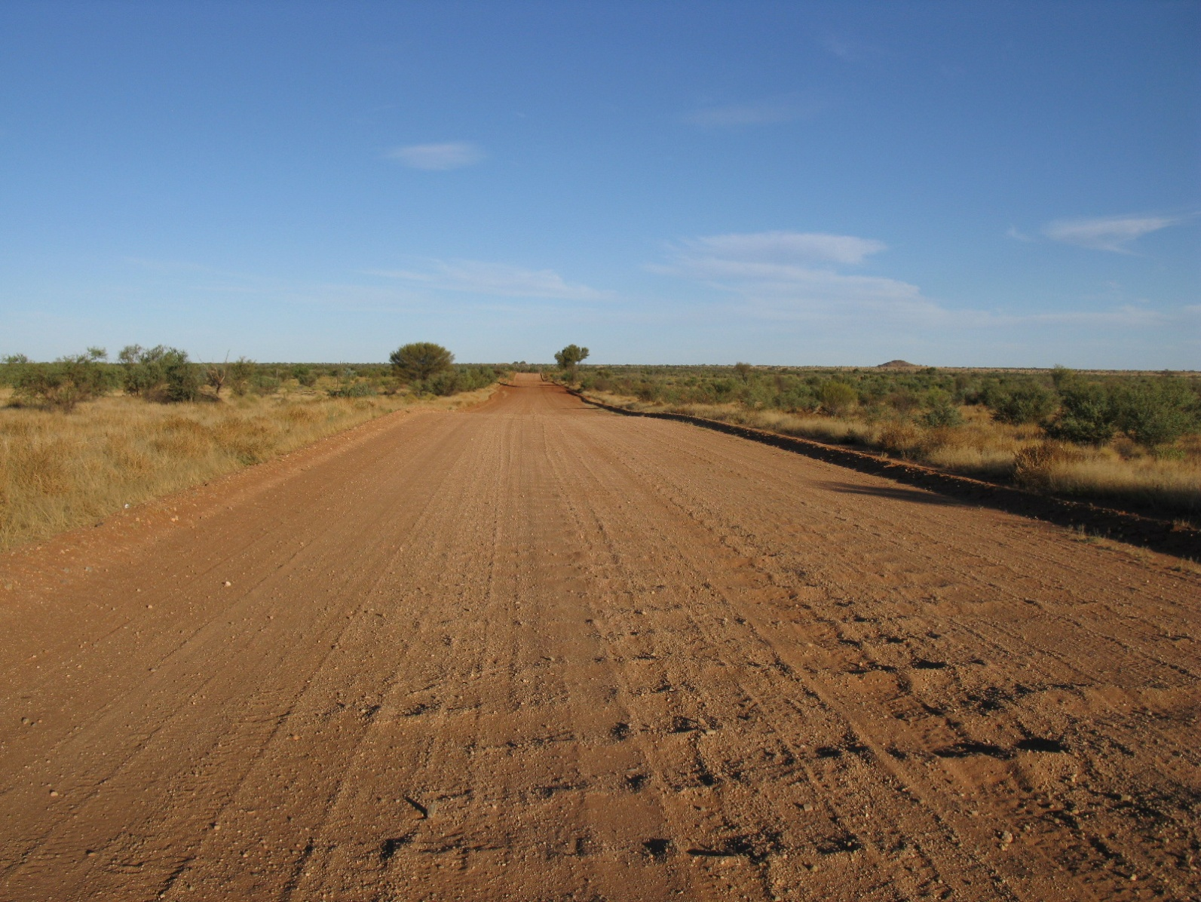
Notes:
In the warmer months, the Main Access Road is highly corrugated

Slide 9
Benefits of upgraded roads
What this means for people living on the APY Lands:
Less wear and tear on vehicles
Improved travel time between communities
Less accidents and injury
Store supplies are less likely to be impacted by road conditions
Notes:
Benefits of upgraded roads
What this means for people living on the APY Lands:
Less wear and tear on your cars
Less travel time between communities
Less accidents, injury
Cultural activities not impacted by road conditions
Store supplies are less likely to be impacted by road conditions

Slide 10
Project Objectives
Focus on:
Protection of heritage sites
Issues of cultural significance
Social outcomes
Children’s future
Employment opportunities – now and into the future

Slide 11
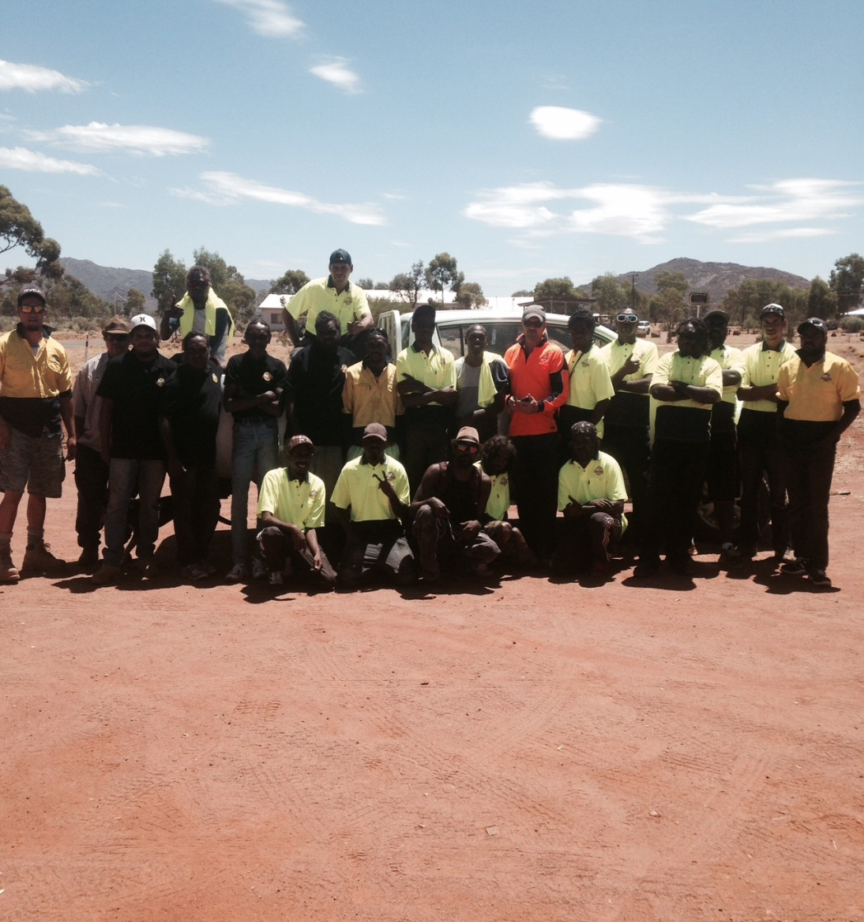
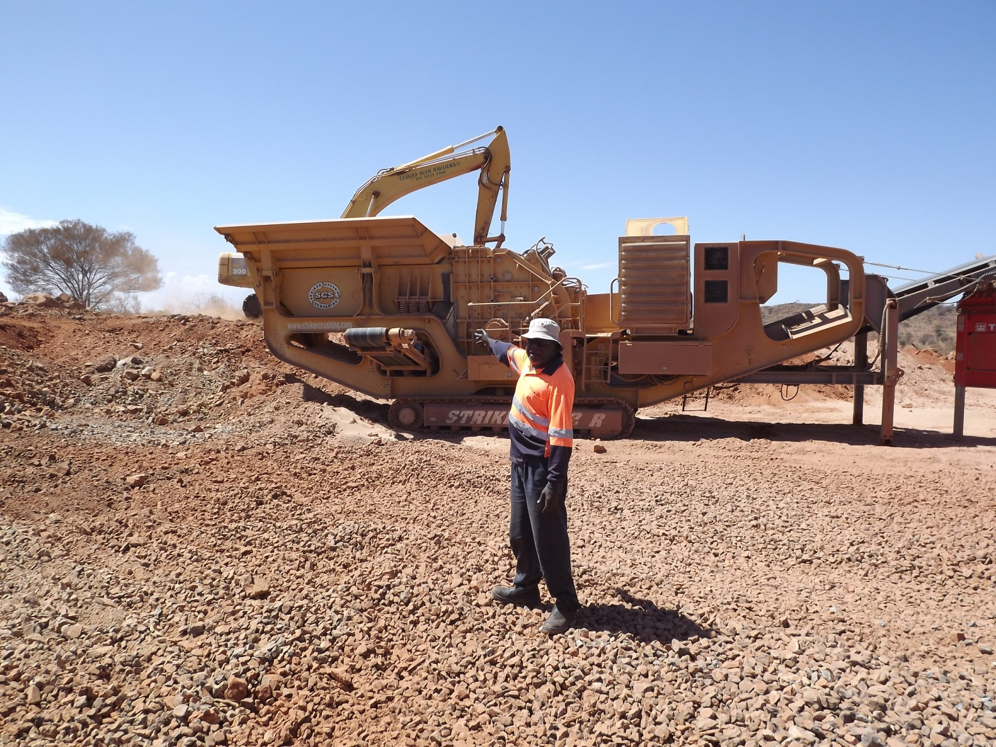
EMPLOYMENT
Notes:
We have engaged a number of monitors and traditional owners throughout our early works phase
Survey assistants have been used for engineering survey works from Umuwa to Pukatja
A number of other organisations are being consulted regarding employment possibilities, including RASAC, the APY Executive Board and local workers.

Slide 12
EMPLOYMENT
A key to the success of the project will be employment of local Anangu
Training placements for local Anangu
Commitment to a minimum of 30% of on-site labour hours to be undertaken by local Anangu
Contractual requirements for employment and training of local Anangu
Explore opportunities for sustainable employment for local Anangu
Notes:
Aboriginal employment
There is an agreed 30% minimum employment target for local Anangu to be employed on the project. This will involve direct and indirect labour.
Direct possibilities: Monitors,Traffic Management, Fauna assessment, Liaison officers, Fencing, general labour, plant operators
Indirect possibilities: Administration services, store caterers, cleaners, horticulture etc
Workzone Traffic Management training is currently being conducted by Skill Hire , with a vision for some of these people to work on the road project

Slide 13
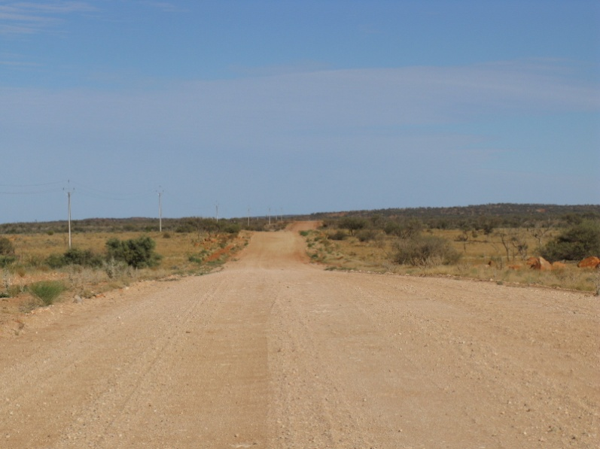
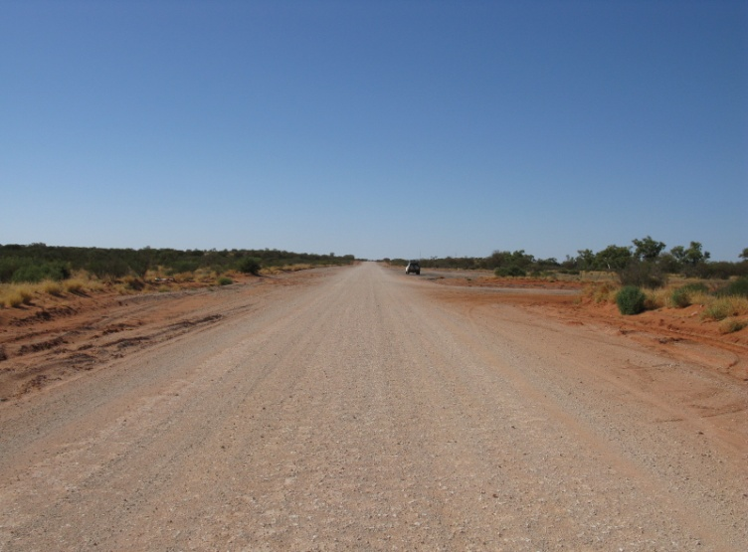
Project Scope
Notes:
Typical cross section = formation and sheeting

Slide 14
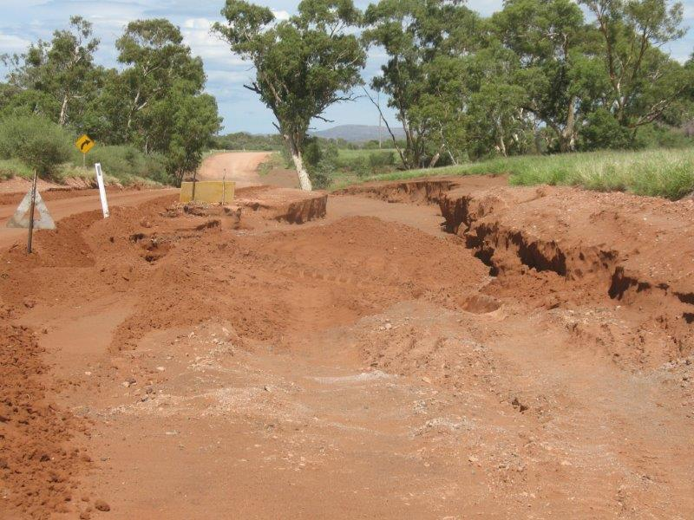
Project Scope
Notes:
Sealing and/or stabilisation works will be undertaken at major creek crossings

Slide 15
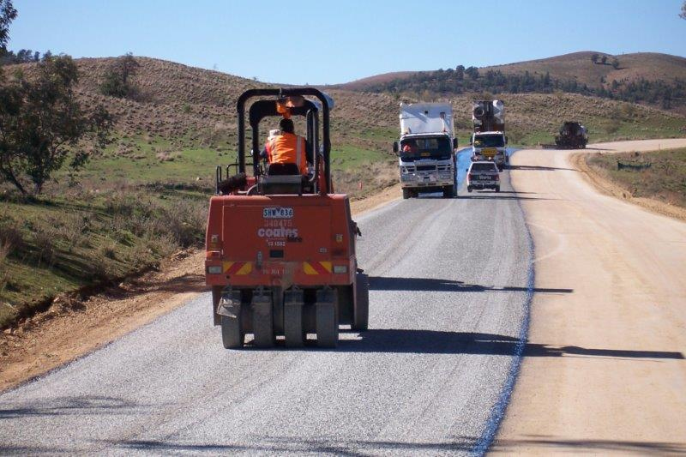
Project Scope
Notes:
Sealing works at community approaches and accesses to sealed airstrips

Slide 16
Project Stages
Planning – now
Survey & Design started November 2014
Early works scheduled for mid 2015
Construction scheduled for late 2015
Ongoing maintenance of the main access road during construction
Plan to complete the project by 2019

Slide 17
Working Together
We will listen and talk from the beginning through to the end. A comprehensive Communication Plan has been developed to:
raise awareness of the project amongst the community and key stakeholders
provide information so you understand the road project and associated works
allow Anangu to express views, ideas and concerns
Notes:
We will LISTEN and TALK from the beginning through to the end
Talk with key people and groups about what is happening and their views
Identify any potential barriers or issues and how they can be overcome
Gain views on progress to date and how things can be done better

Slide 18
Things that are important to us
Respect of Sites (Cultural and Environmental), Men and Women
Opportunities for Anangu employment, training, mentoring and work experience
Lore and Culture training for the project team and contractors
Road safety education
Making the road safer

Slide 19
What you will see in the coming months
Notes:
Posters
Material Crushing
Water boring
Turkeys Nest
Vegetation Clearance
Road Construction – Pukatja to airstrip
Photo

Slide 20
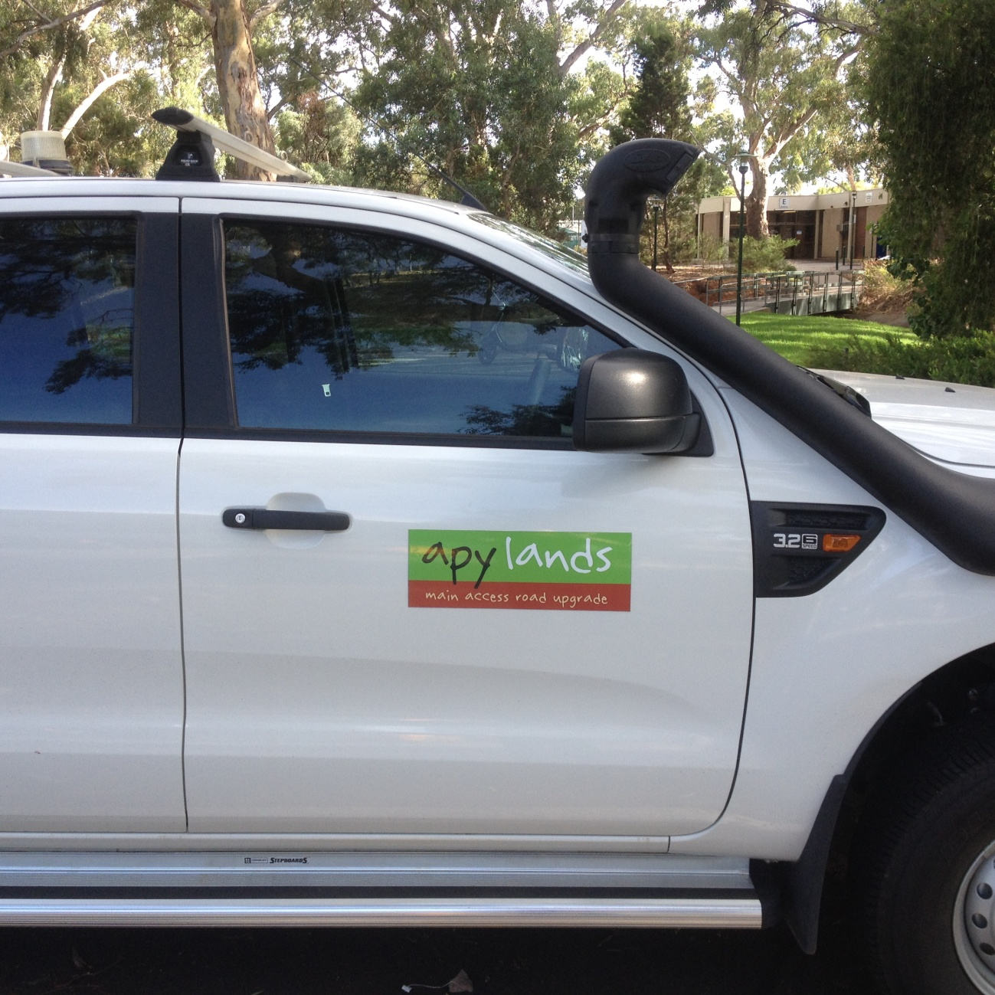
Project team identifiable branding
Notes:
Posters
Material Crushing
Water boring
Turkeys Nest
Vegetation Clearance
Road Construction – Pukatja to airstrip
Photo

Slide 21
Audio Posters to be installed in Communities
Notes:
Posters
Material Crushing
Water boring
Turkeys Nest
Vegetation Clearance
Road Construction – Pukatja to airstrip
Photo

Slide 22
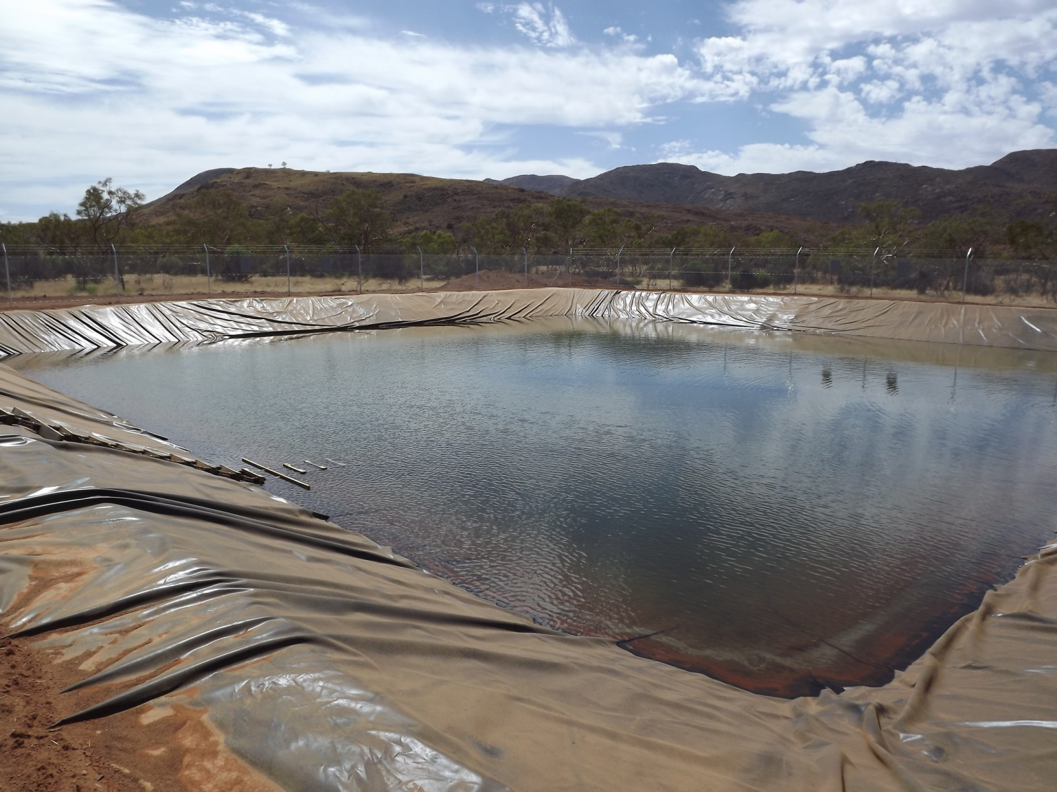
Construction water storage
Notes:
We will not disturb Community Supplies

Slide 23
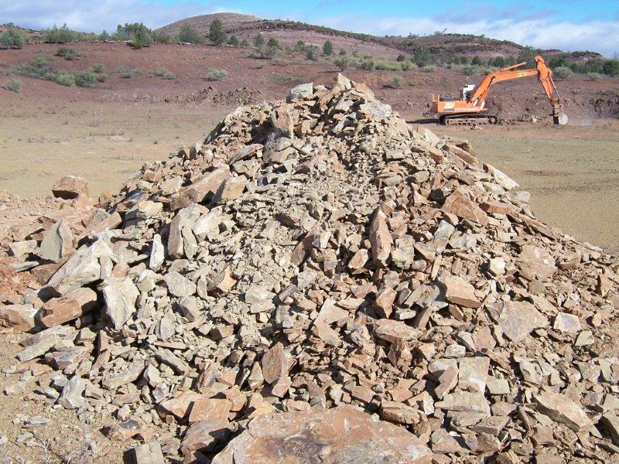
Crushing plant established
Notes:
Extensive material searches are required

Slide 24
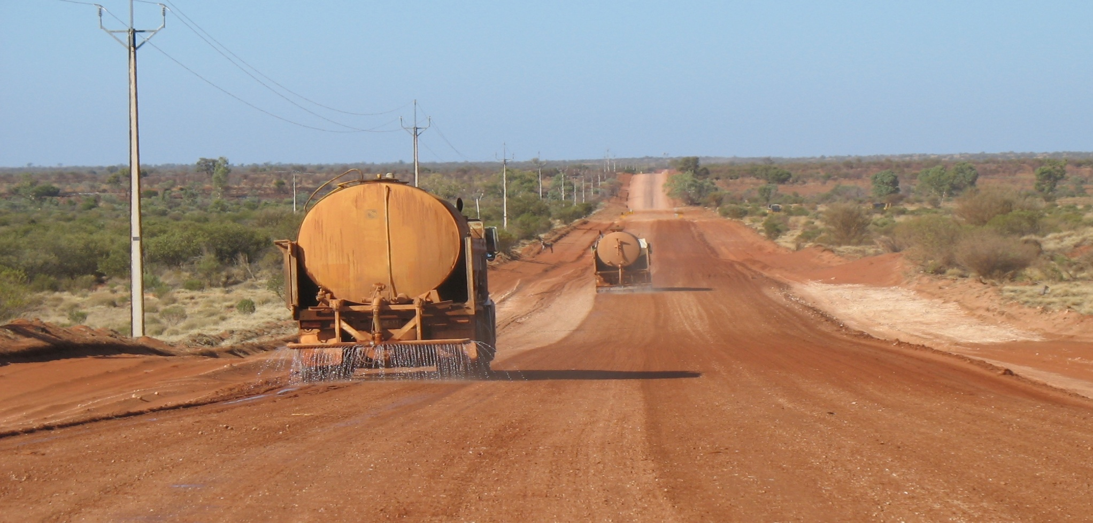
Formation and sheeting
Notes:
Commence construction at:
Pukatja to airstrip road,and
Indulkana to Stuart Highway
Resheeting and formation of the road

Slide 25
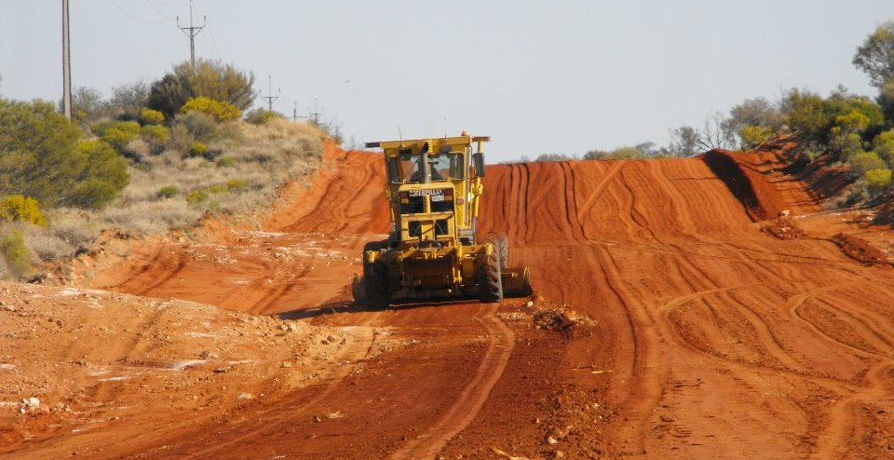
Maintenance grading will continue
Notes:
Existing Maintenance Grading Contract to continue – more focus on western communities and roads as main access road will require less maintenance

Slide 26
Notes:
Posters
Material Crushing
Water boring
Turkeys Nest
Vegetation Clearance
Road Construction – Pukatja to airstrip
Photo

Slide 28
QUESTIONS?

