Slide 1
Rules
& Laws
Notes:
For teachers instruction guide go to (website link)
Question on each slide will appear with each mouse click.

Slide 2
Behaviours that show…
RESPECT | CARE | EFFORT
Notes:
Record examples of behaviors as a class, students to record in their SLJ what they will focus on doing to demonstrate responsible behaviors.

Slide 3
But what about when we are out on the road in traffic with people who aren’t from our school… how do they know what to do?
Notes:
Discuss how following the Way2Go Bike Ed rules helps keep them safe and makes the sessions enjoyable for everyone. Pose a problem by asking question on PPT.
Allow this step to set the scene for why we have laws by pausing to create an atmosphere of intrigue, rather than telling student the answer.

Slide 4
Notes:
Explain what a traffic law is and why we have them.

Slide 5
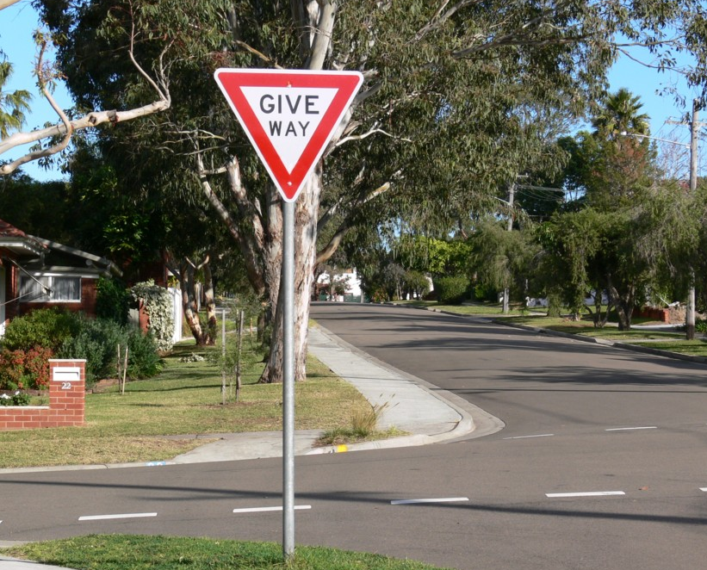
think – pair - share
Imagine life without traffic
laws…
What would
everyday
travel be like?
Notes:
Discuss laws that images represent before having students imagine life without traffic laws
(Compulsory use of a helmet on public roads, following speed limits, traffic signals and signage etc)

Slide 6
The difference between rules and laws
Way2Go Bike Ed rules | Traffic laws
Notes:
Teacher notes
See instruction guide for table of information

Slide 7
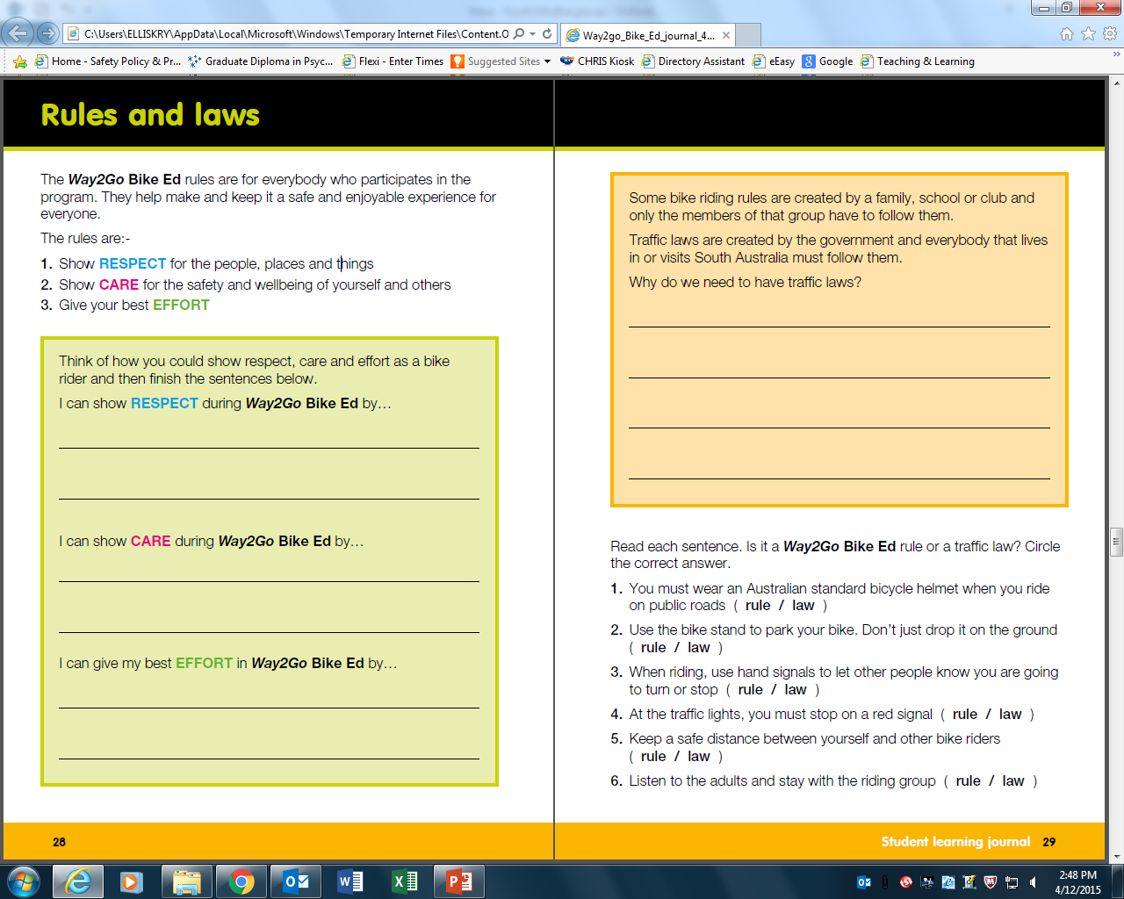

Slide 8
Notes:
Students who finish earlier to complete pg 24-25

Slide 9
Think about… Parts of a bike Verbs and adverbs that describe how to do the action
Notes:
Early finishers continued…

Slide 10
What is the purpose of a school zone? (What does the sign aim to get people to do and think about?)
Notes:
Ask class if they have seen these signs outside their school or near another school. Follow with discussion on the purpose of a school zone.

Slide 11
Why have a school zone? Why is it important to think about the safety of everybody when arriving at or leaving school?
Notes:
Teacher notes
Why have school zones? (Think about speed and people’s safety)
Why is it important to think about the safety of everybody when arriving at or leaving school? (Guide students to think about everyone’s right to be safe, regardless of their mode of transport - walking, riding or travelling by car) Probe students to consider how traffic laws reflect Australian values, such as respect and inclusion

Slide 12
Notes:
Teacher notes
Extension idea - Consider how the students could take a leadership role in raising awareness about the school zone and promote safer driver and pedestrian behavior at drop off and pick up time.

Slide 13
Come to a complete stop
Slow down and give way to traffic if present
No bicycles in this area
Area, path or lane for bicycle only
Shared use path for pedestrians and bike riders

