Slide 1
Getting Organized
Notes:
For teachers instruction guide go to (website link)
Question on each slide will appear with each mouse click.

Slide 2
Who has ridden a bicycle before? Why?
Are there any other reasons that someone might ride a bike?
What might you need to know or be able to do to ride a bike safely?
Notes:
Teacher notes: Point c - Record ideas so that students can refer to this if needed when they create their own goal.

Slide 3
Creating a Way2Go Bike Ed SMARTer goal
Elements | Example A | Example B
Specific | My goal is to learn how to cook food | My goal is to learn how to ride in a straight line by the end of the second week
Measureable
Achievable
Relevant
Time bound
Evaluate
Redo
Which example is a SMART goal? Why?
Why evaluate or redo a goal?
Notes:
Teacher notes: Share the benefits of creating SMART targets to achieve a goal.
Describe elements then compare examples.
Discuss questions one might ask to evaluate their success in achieving their goal.
Discuss times when to persist or adapt the goal before a redo.

Slide 4
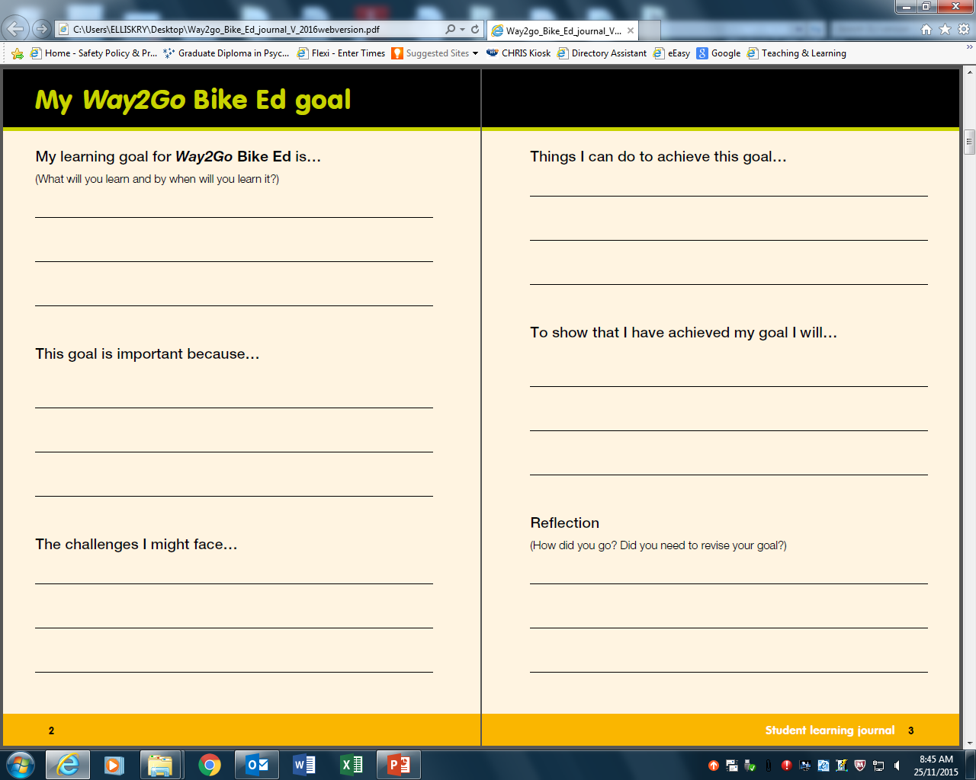
My goal page from SLJ
Notes:
Teacher notes:
Refer to the class ideas about things you need to know and do to ride safely and model how to complete the task.
Things I can do to achieve this goal - Actions and attitudes that will support success
- More capable students could research facilities, riding groups or sources of information that could assist them. E.g. explore cycle instead journey planner online to find quiet bike routes to practise skills.
Early finishers to read pg. 7 – 8 and complete if they own a bike.

Slide 5
Ready
to
Ride

Slide 6
Last night I was really excited about being allowed to ride to school this morning. It’s my goal to do it every Wednesday. Today I got up late because no-one woke me up! I was in such a rush to get ready it time and I couldn’t find one clean pair of socks in the mountain of laundry… garh! Then my big sister moved my homework from the kitchen table to eat breakfast so I was searching the house frantically looking for it to put it in my bag…Grr! And then to top it off my helmet was in the shed and dad took the keys to work so I couldn’t get it out. So mum said “not today” and made me go in the car with her. I was so disappointed.
Notes:
Teachers notes: Either read out loud of give the class time to read it independently.

Slide 7
What went wrong? Why?
What could have prevented this problem?
Notes:
Teacher notes:
Guide discussion to conclude that being organised helps one to achieve intended goals.

Slide 8
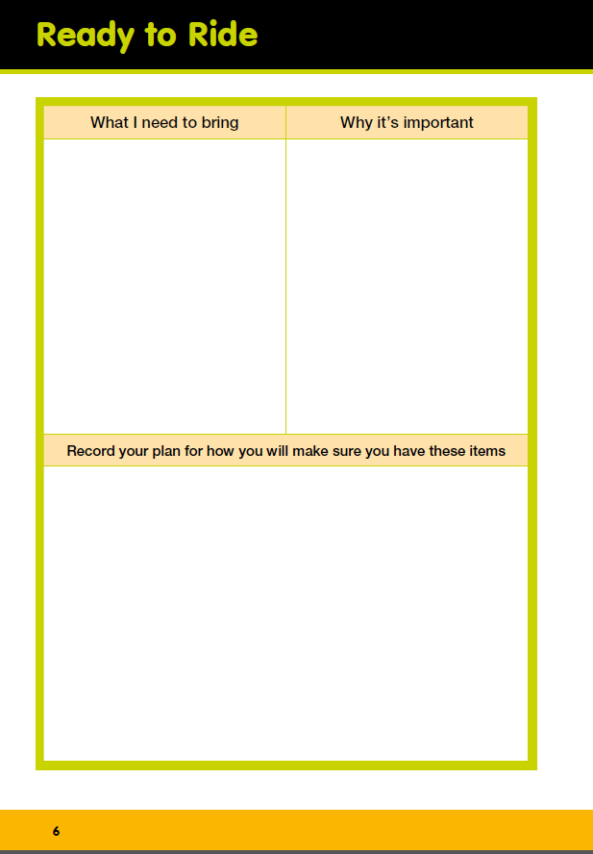
What might you need to be ready for Way2Go Bike Ed?
Think about…
What will the weather be?
What kind of shoes and clothing are good for bike riding?
Any other items you need to stay safe?
Your plan should include how you will get organised.
Notes:
Teacher notes: Instruct students to use bullet points. Emphasize that the plan should include how they will collect the items, and that it will be their responsibility to remember.

Slide 9
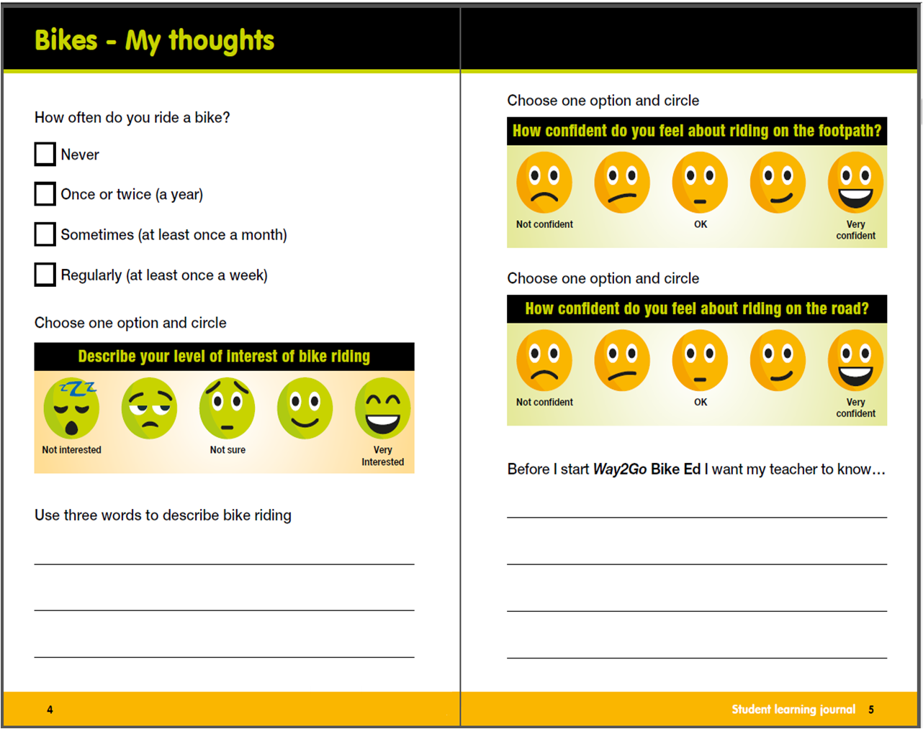
Once you’ve finished…
Choose an activity
Notes:
If not completed in class, have student do it as homework or at another time during school.

Slide 10
Odd one out investigation
Spot the odd one out.
Put your hands on your head when you spot it.
Record the time it takes to spot the odd one out.
First group (seconds) | Second group (seconds)
1. 2. 3. | 1. 2. 3.
Online stopwatch
Notes:
Teacher notes
To avoid students pretending to know what the odd one out is before they really do tell them that you might randomly ask someone what the odd one out is to check.

Slide 11
First group

Slide 12


Slide 13


Slide 14


Slide 15
Second group

Slide 16
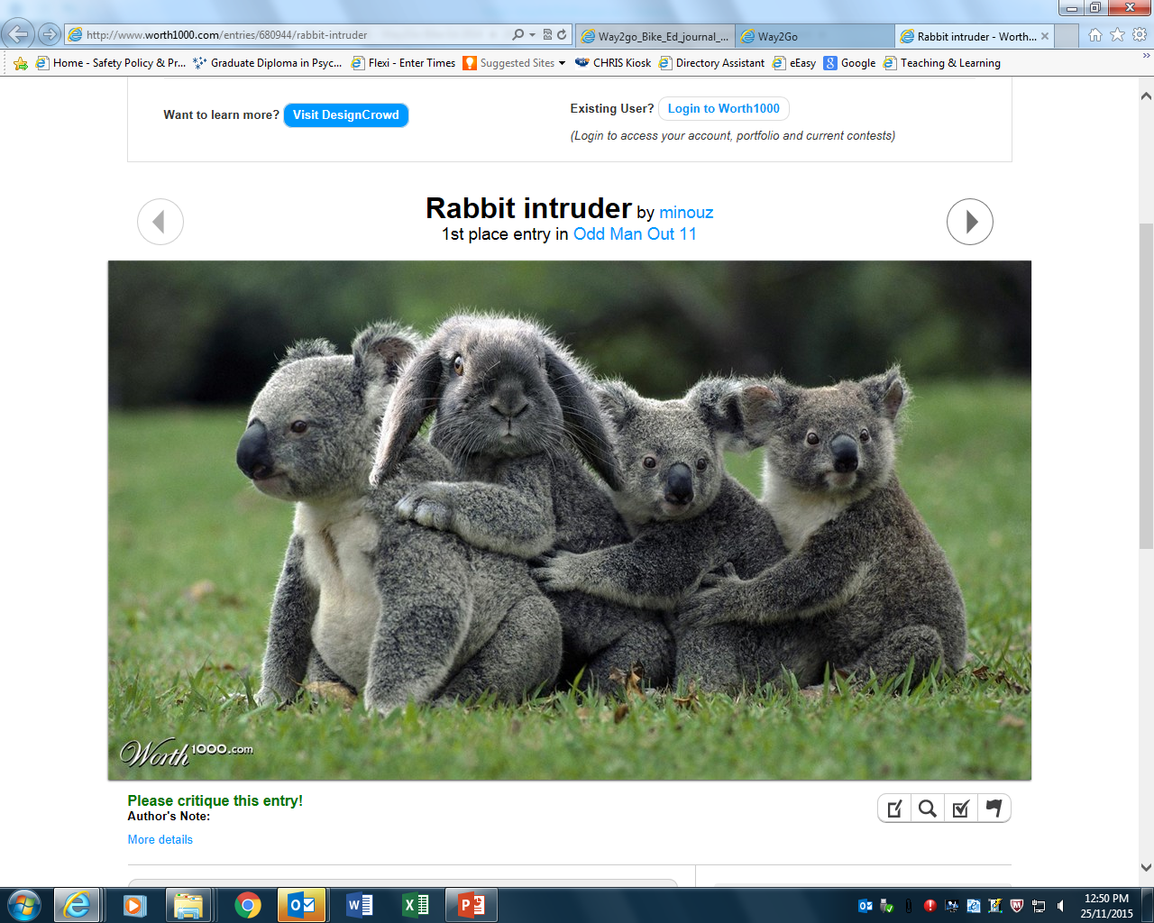

Slide 17
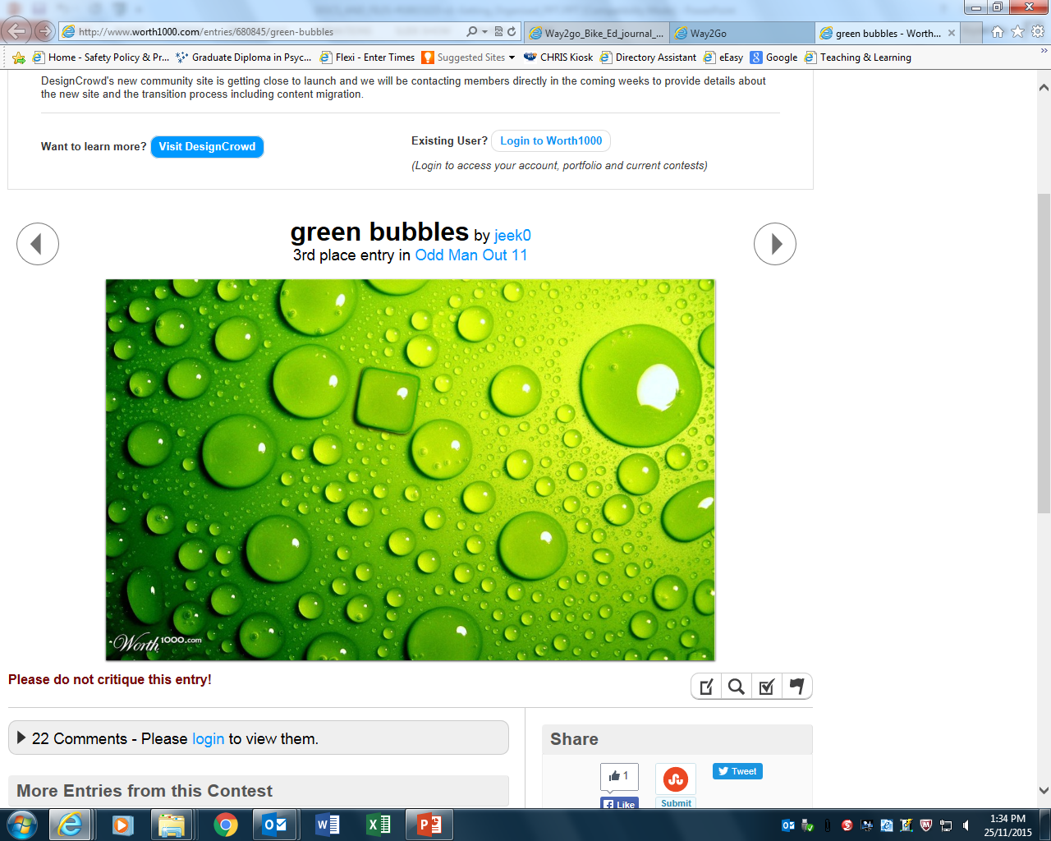

Slide 18


Slide 19
Compare the results
What is the time difference between each group? What could be the reason for this?
What might have influence our results?
What is our conclusion?
Notes:
Teacher notes
Students may conclude that wearing bright reflective clothing means others will see them. Clarify that it is more likely they will be seen, and that safe behaviour is just as important. If students own bright clothing encourage them to wear it if they are riding their bike to school for Way2Go Bike Ed.

Slide 20
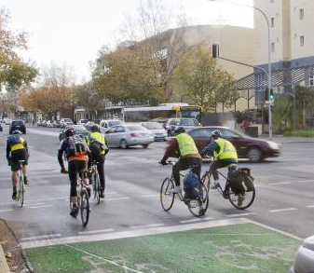
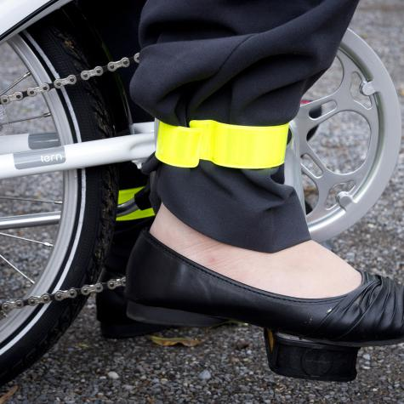
The instructor will give you a bright vest with a number on it. Remember which number you are and use the same one for each session. Put your vest on at the start of every session.
Other tips
If you have laces, tuck them in to you shoes so they don’t get caught in the chain.
Tuck your pants into your sock or use a reflective strip.
Notes:
Teachers notes
Have students review their ready to ride list and record new in about bright clothing.

Slide 21
Next lesson we will learn…
What is a safe helmet for bike riding?
How do you fit a helmet correctly?
If you have a helmet you must bring it in for the lesson. If you don’t own a helmet see if you can borrow one from someone else for the day.

