Slide 1
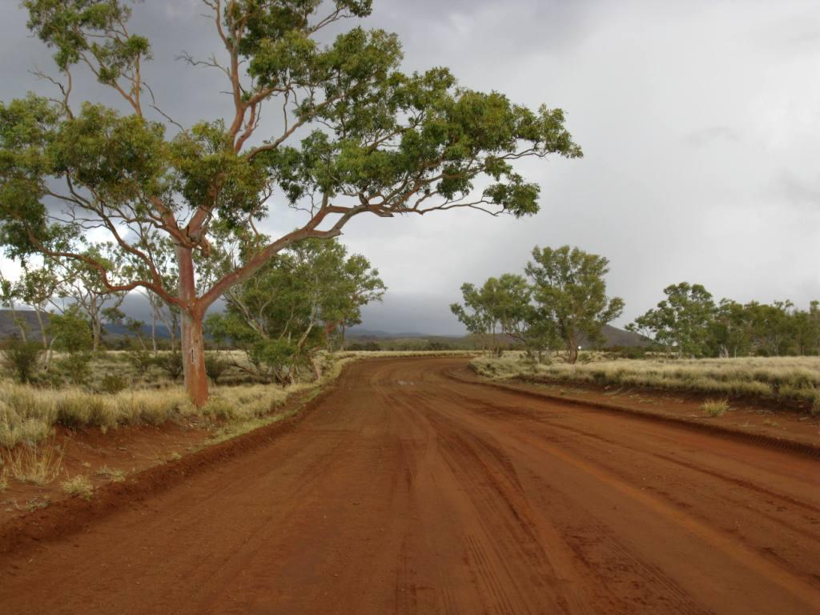
Nyurampa Iwara
Notes:
Nyurampa Iwara – Your Road

Slide 2
Project Objectives
Form Partnership and collaboration through direct engagement with APY Board, Traditional Owners and Community Leaders
Listen and work out problems to find solutions

Slide 3
Project Objectives
Celebrate success together
Focus on:
Protect heritage sites
Issues of cultural concerns
Social outcomes
Children’s future
Employment opportunities – now and future

Slide 4
Where To From Here
Critical Activities - Now
Consent to undertake works
Formalise route
Proposed Project Workshop

Slide 5
Consent to Undertake Works
Anangu Pitjantjatjara Yankunytjatjara Land Rights Act 1981
Division 6 - Construction of roads by the Commissioner of Highways:
Consent required for road works

Slide 6
Formalise Route
Negotiable and Non Negotiable
Minor Realignments
Alternative route

Slide 7
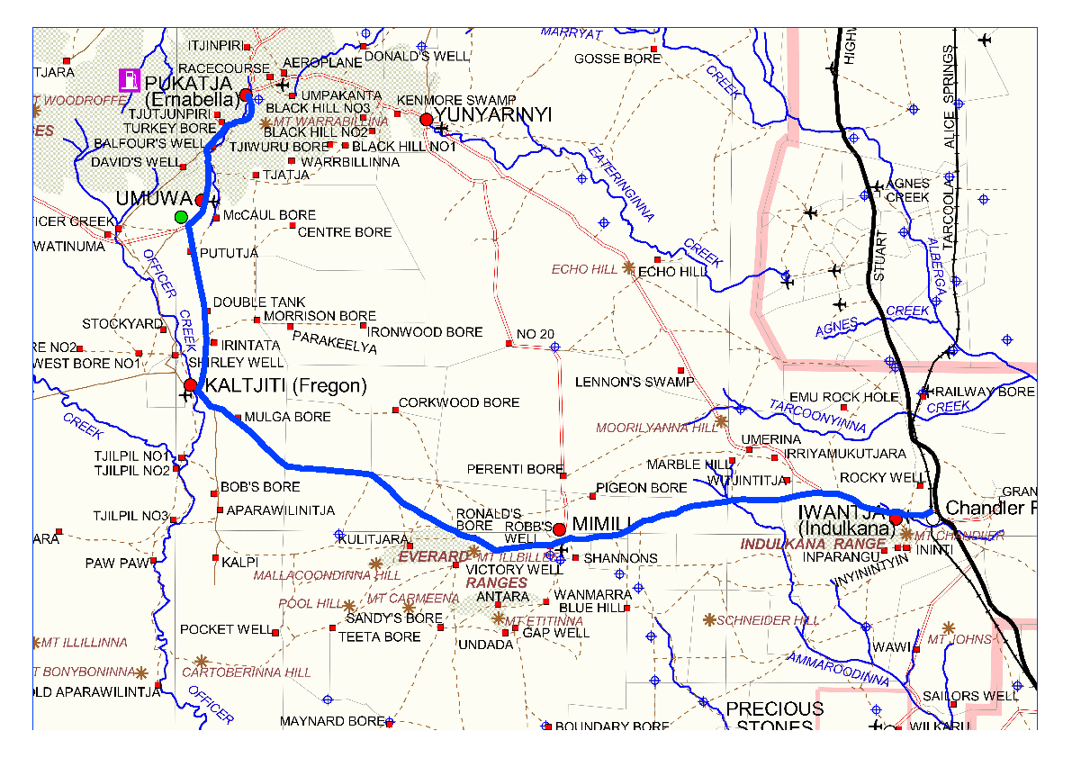
Main Access Road
Notes:
Upgrade of current Main Access Road
A total of 210kms of main road and approximately 30kms community & airstrip access roads

Slide 8
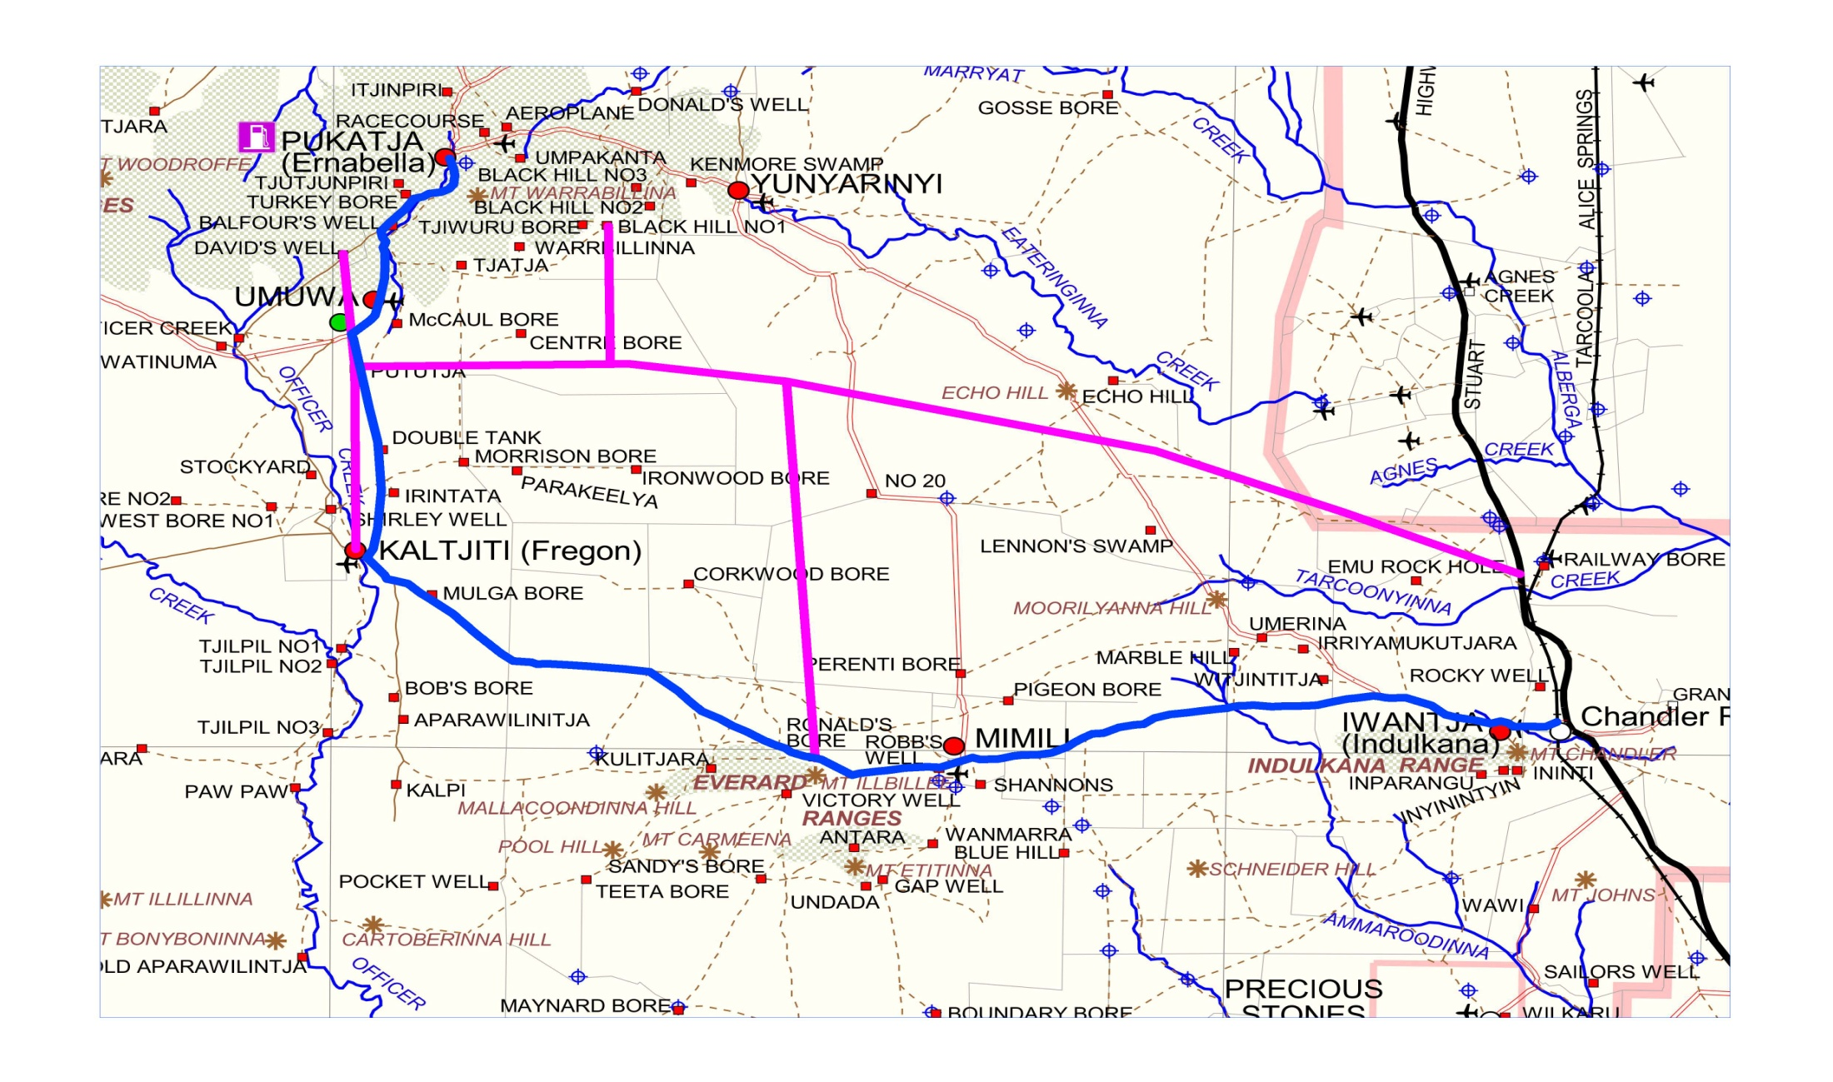
Proposed Alternative Route
Notes:
Proposed Alternative Route as presented by APY Staff and Board Member to DPTI (Barry Lewis)
(Bernard Singer – Chairman, Rex Tjami Director of Administration and Gary McWilliams – Mining Tenement Officer)
Estimated 241kms, no community access roads
Vegetation Clearance Approximately 4.82km2

Slide 9
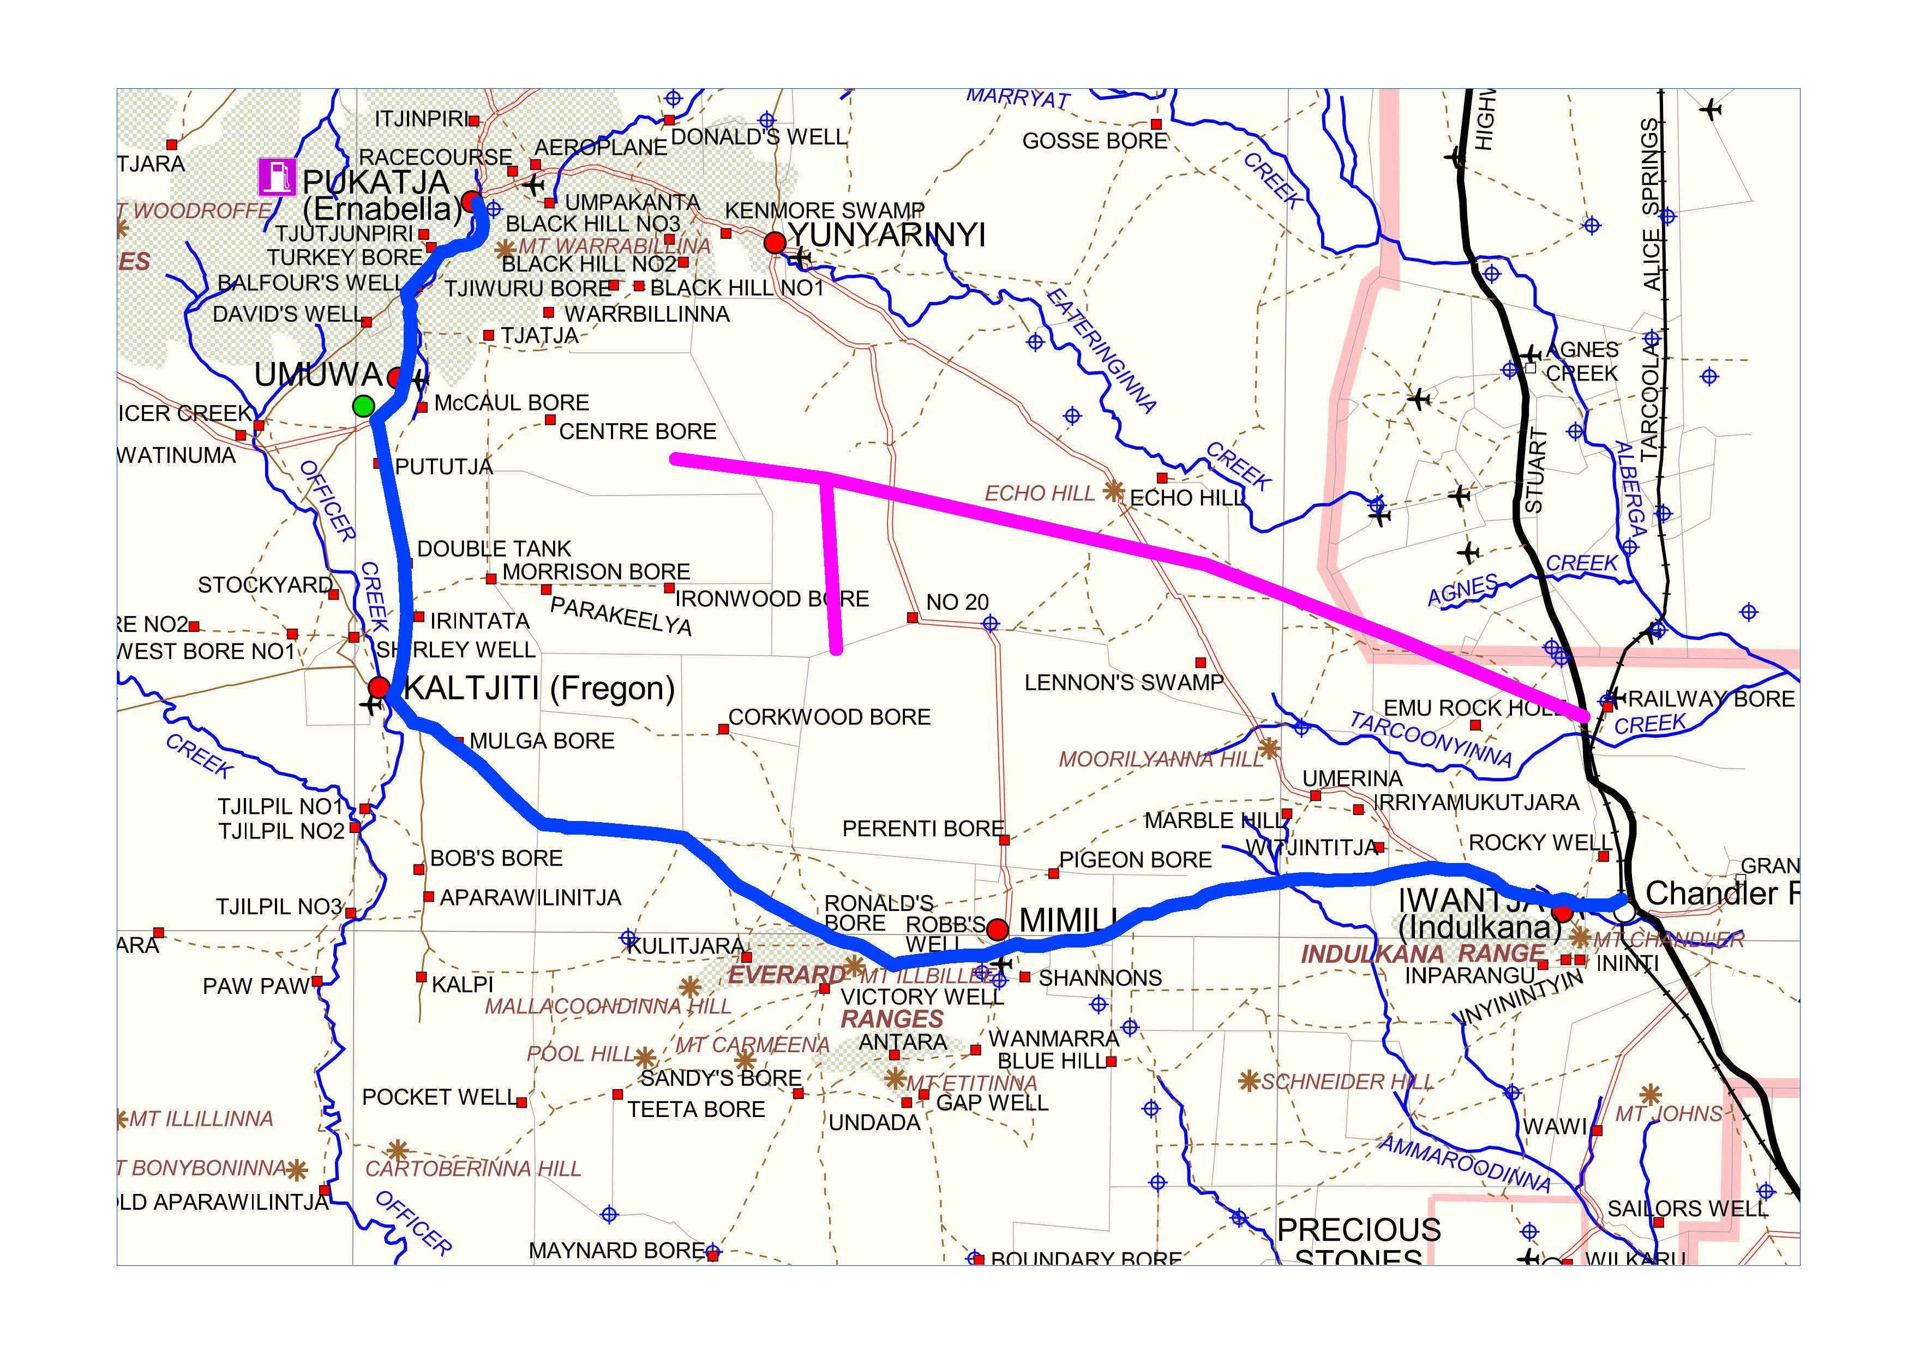
Proposed Alternative Route
Notes:
No additional funding for alternative route
Funding runs out mid project
This road needs to cater for all communities

Slide 10
Proposed Project Workshop
We will Listen and Talk from the beginning to the end to:
Raise awareness of the project amongst the community and key stakeholders
Take into account the views of the community during the design process and factor this into the construction phase
Notes:
Manage community issues associated with construction to allow works to continue on time and on budget
Implement a proactive media venture
Maintain a professional working relationship with statutory authorities, council, agencies and other stakeholders

Slide 11
Key Areas of Focus:
Regional Partnership Agreement
Engagement and Consultations
Anangu Training and Employment
Project Reference Group
Lore & Culture Training
On going update to APY Executives
Notes:
Regional Partnership Agreement
Agree to project plan, process and outcomes by all three partners in this agreement which are: APY, State and Commonwealth Government
RPA Working Group established to develop a schedule to define how the project can contribute to the priorities and socio-economic objectives outlined within the agreement
Engagement and Consultations
Identify: Who are the key people and groups that need to be involved. What role do the key people and groups play
Connect and Share: Develop a communication plan to share and receive information
A comprehensive community engagement plan is required to ensure that Anangu:
Are provided information so they understand the road project and associated works
Have their concerns listened to, issues understood and taken into consideration
Can express their views and concerns
Anangu Training and Employment
Develop opportunity for ongoing training and employment
Project Reference Group
A proposal that a Project Reference Group be set up to support the project with representatives from APY Board, Community Councils, DPTI, PMC, DSD-AAR
Lore & Culture Training
Lore & Culture Awareness Program for the Project Team

Slide 12
Proposed Project Workshop
To be facilitated
Date
Location
Travel Arrangements
Sitting Fee’s
Notes:
Proposed Facilitator (Ian Dixon)
Date (Wednesday 27 August)
Location (Alice Springs)
Travel Arrangements (APY and DPTI Administration – Funded by the department)
Sitting Fees (Purchase Order)

Slide 13
Where To From Here
Critical Activities - Now
Consent to undertake works
Formalise route
Proposed Project Workshop
Notes:
Consent – Signing of agreed route as per project plan (copy for each party)
Will allow critical activities to commence such as survey, detailed land survey as well as aerial survey
Start talking to Communities about the project – Pukatja and Umuwa first

