Slide 1
Making
decisions
Notes:
For teachers instruction guide go to (website link)
Question on each slide will appear with each mouse click.

Slide 2

The lolly predicament…
You could eat it now
OR
Wait until I say you can eat
it and then have two lollies
What action could you take?
What is the consequence/s of each choice?
Notes:
If preferable swap this decision with another simple predicament

Slide 3
Is the consequence wanted, not wanted or are you unsure?
Choices | Consequences | Wanted, not wanted, unsure
Is one consequence wanted or not wanted more than another?
Notes:
Encourage students to consider how others might influence them and if this is helpful - e.g. peer pressure to eat it lolly now even if you want to wait.
Ask students to make their own decision individually and then ask for volunteers to share their decision and reasons with the class.

Slide 4
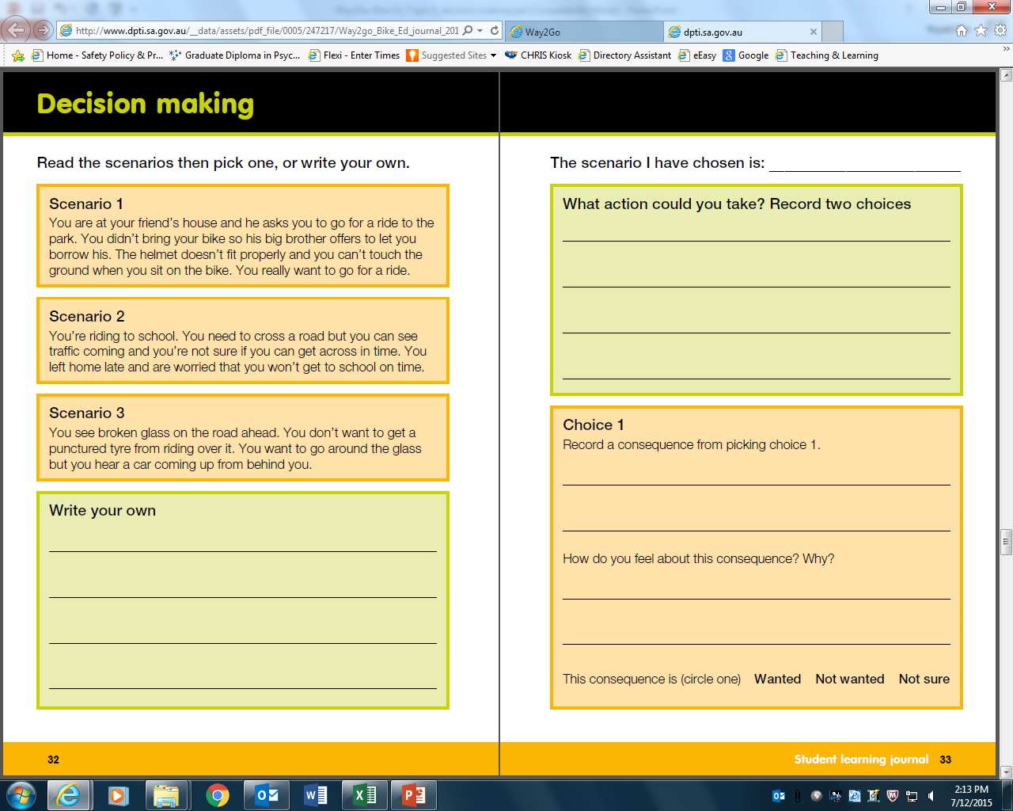
Notes:
Refer students to pg. 32 - 34 in their student learning journal and ask them to choose one scenario or write one of their own that relates to bike riding. Check their understanding of the task, if needed provide additional help by modelling one of the listed scenarios before students move off to work individually.
Encourage students to consider how others might influence them and if this is helpful.
eg. Scenario 1. Peer pressure to ride using unsafe equipment.

Slide 5
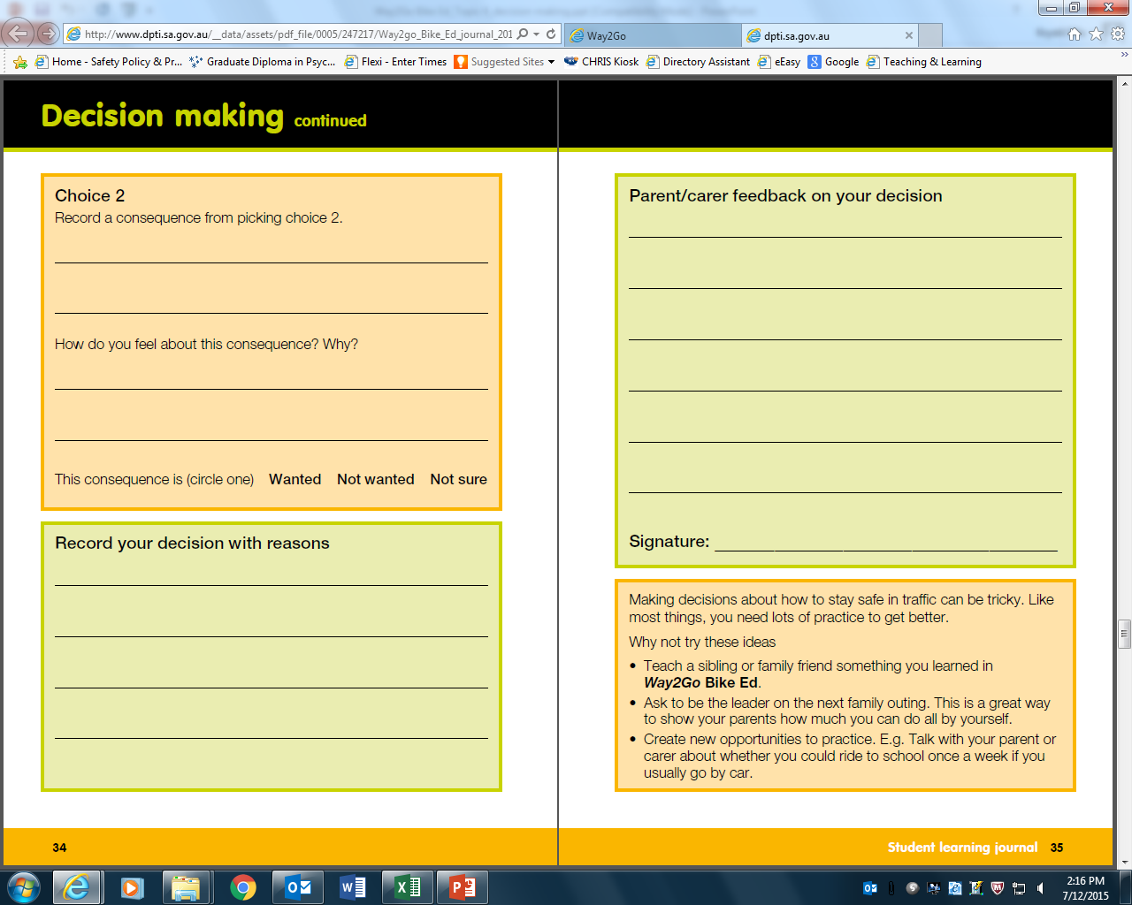
Notes:
Have students share their decision with a parent or carer. The parent provides feedback that the student records. The parent signs on pg. 35.

Slide 6
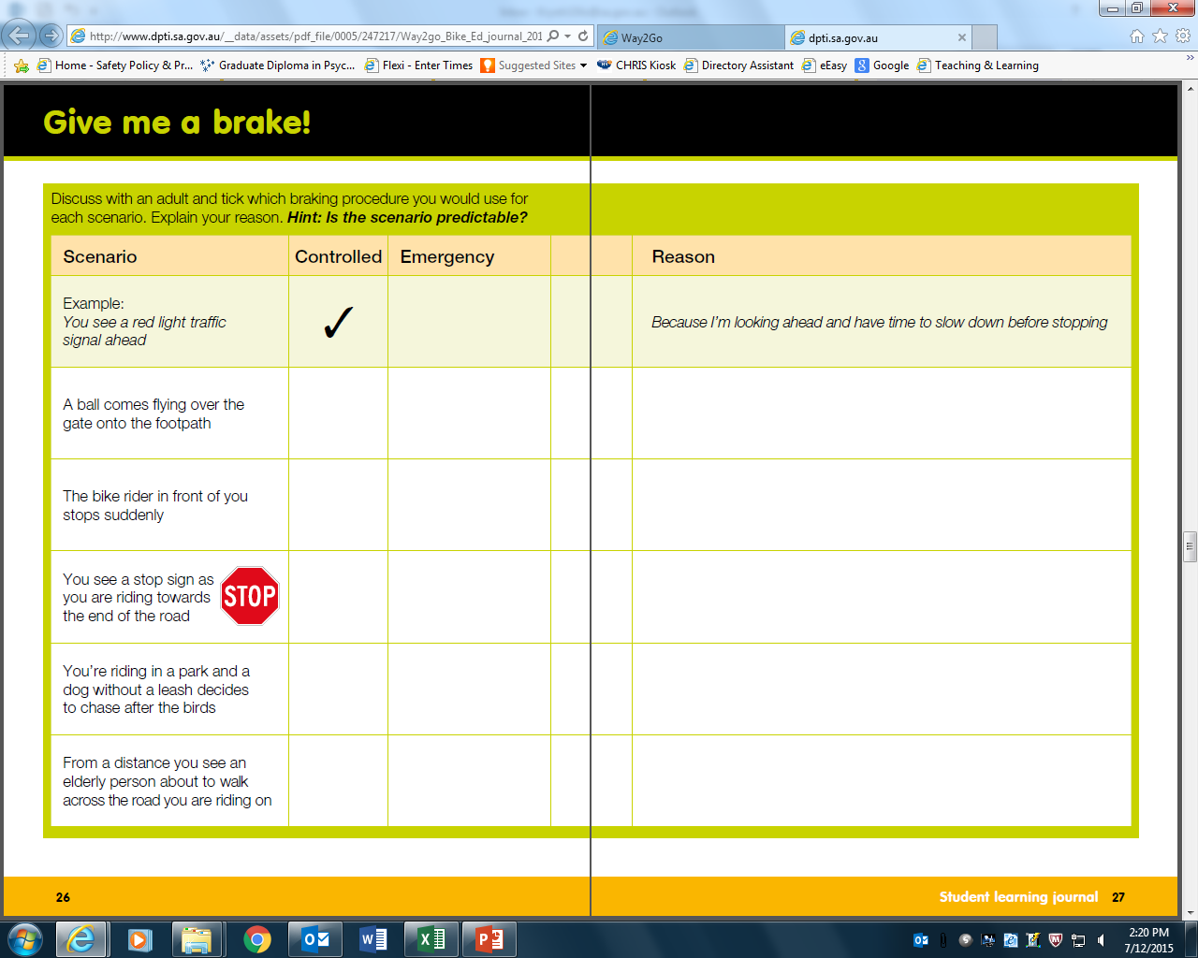
Notes:
For students that finish early, have them complete the activity on pg. 26-27. Direct students attention to question whether the scenario is predictable. Spot language that describes the scenario (e.g. suddenly). If it is predictable then they should record a controlled brake procedure.
Consider having students record their experiences in making a decision after each practical session on pg. 36-37. Encourage the inclusion of responsible behaviors as a learner.

Slide 7
The junctions quiz
Notes:
You may negotiate to do the junctions quiz in the practical session with instructors. Check with your Way2Go Bike Ed coordinator.

Slide 8
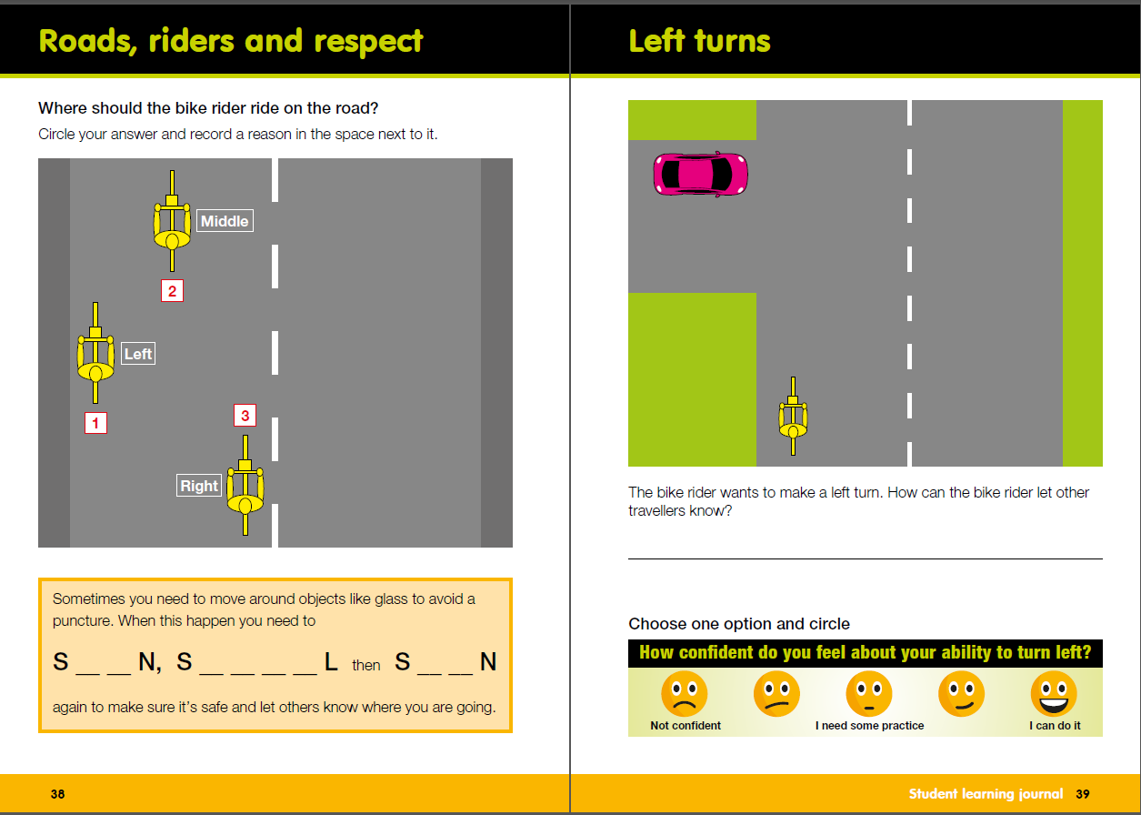
Notes:
Roads, riders and respect – Have students circle option 1, 2 o3 3 and fill in the rest of the words if they know them.
Left turn – explain that they can record how confident they feel about doing a left hand turn after the practical session.
Refer to the answer sheet for more information

Slide 9
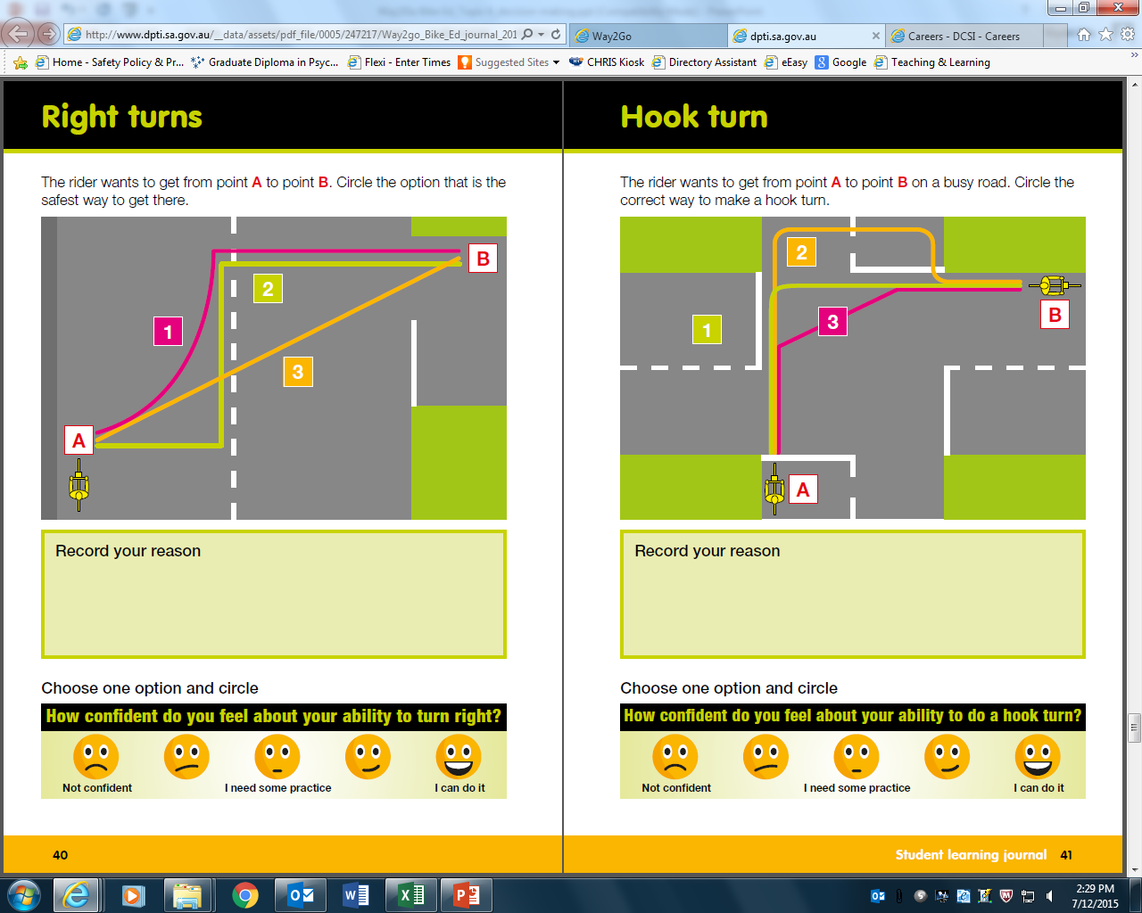
Notes:
Have students circle route number 1, 2 or 3 and provide reasons in dot point format. Highlight key word – safest option

Slide 10
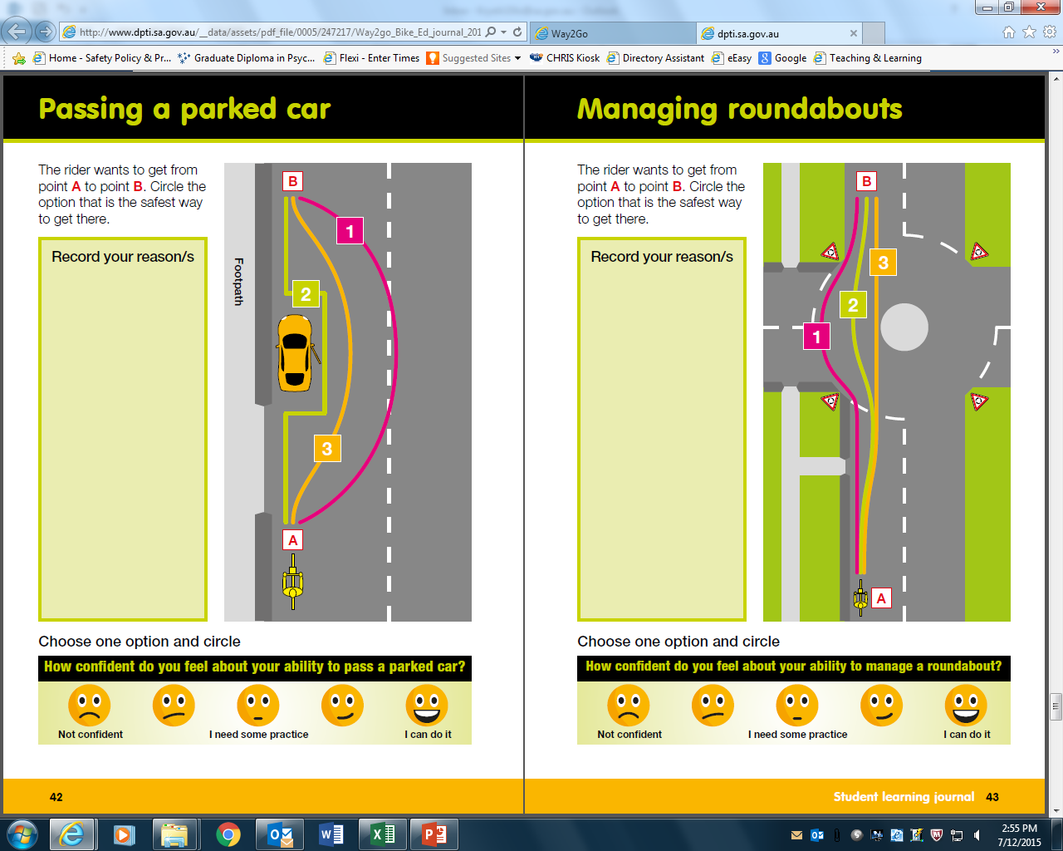

Slide 11
With whom could you carry out this quiz?
Notes:
Students then identify an adult with whom they could conduct the quiz and plan when they will do it. Once they have completed the quiz they share the correct answer and discuss the reasons behind it with the adult.
Once students have completed the quiz with an adult consider summarizing how many answered each question correctly. Analyze the data by asking them what it might mean for drivers and bike riders sharing the road safely. Explore what action they could take to promote safe travel in the local community.

